Slide 1
Goal for presentation
Churn Predictive Model Example
Documentation of Analysis
Objective Model Evaluation
Quick R demo – from churn example

Slide 2
Predictive Churn Modeling
eBusiness Analytics
10/21/2015
By
Jennifer Landis & Christopher Brossman

Slide 3
Presentation contents
TOPIC PAGE
Goals……………………………………………………………………………………..........….3
Executive Summary…………………………………………………………………………..4
Definitions………………………..……………………………………………………………….5
Sample Data………....................................................................6
Predictive Model…………………………………………………………………………25-38
Using Churn Predictions…………………………………………………………….39-40
Further Research……………………………………………………………………….….…41
Appendix A……………………………………………………………………………….42-116
Appendix B………………………………………………………………………….…117-119
5
6
7
8-22
23-34
35-39
40
41-116
117-119

Slide 4
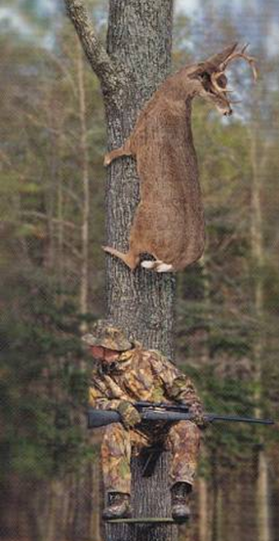
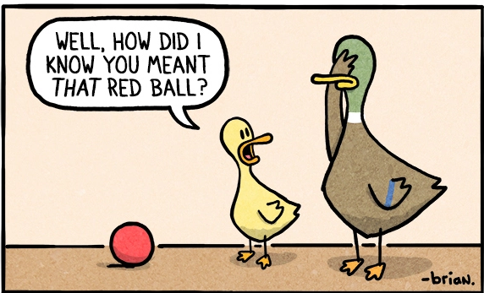
Need for better targeting
Back

Slide 5

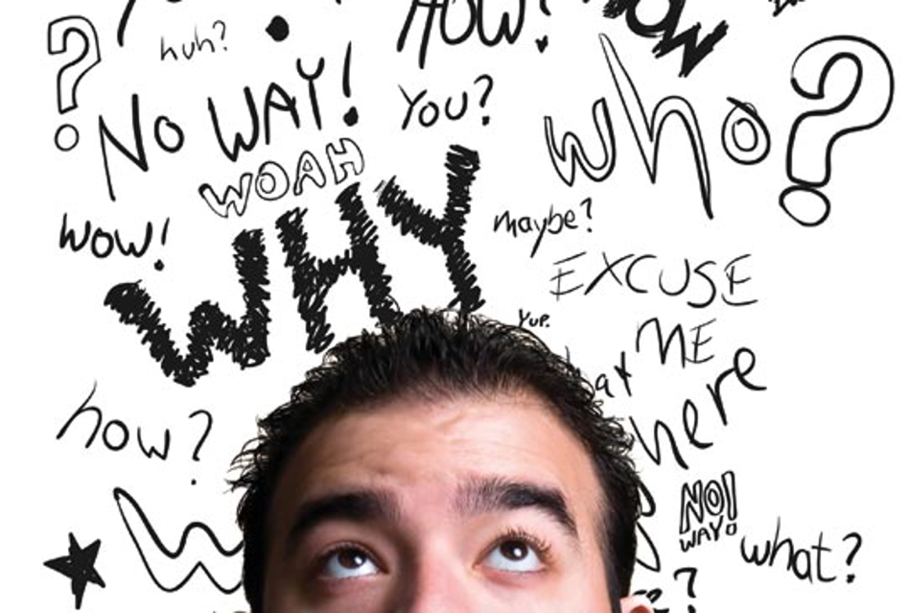
Why is churn bad?
It’s 6-7 times more costly to acquire a new customer than it is to retain an existing one
Increasing retention rates by 5% increases profitability by 25-29%
Loyal customers are worth up to 10x as much as their first purchase
Next month, we will lose between $2-5 million due to churn
Harvard Business School

Slide 6
Goals of analysis
Describe & summarize the churn history
Develop a predictive model to pick customers most likely to churn
Combine customer churn model with CLTV & FOL sales to prioritize investment
Back

Slide 7
Executive Summary of findings
Historic Summary
The churn rate has grown and stabilized in recent years
If a customer churns, that customer has a 60% probability of becoming an ordering customer again regardless of intervention
Predictive Churn Model
Churn model is able to predict churn with about ~80% accuracy
Entire analysis, distribution and integrations of systems is completely automated and tested
Back

Slide 8
Definitions
Ordering Customer: a customer who placed at least one FOL order in said current month
Churned Customer: a customer who placed an FOL purchase in one month, and didn’t place an FOL purchase in the subsequent month
Reengaged Customer: a customer who placed at least one FOL order in said current month, when they weren’t an FOL customer or had churned in the previous month
Rolling: a variable aggregated over a rolling 12 month window
Rolling Mean Index:(Manual Sales % of customer i in price column c) – (Manual Sales % in price column c) + 100
Forces to be positive, ranges from 0 to 200
Manual sales same as price column = 100
100-200, poorly priced customer
Under 100, good pricing for that customer in that price column
DLOG: a variable logged and differenced
Dominant Type II: a customer categorization combining friendly profile, KOB, customer type and price column
Accuracy: percent predicted into correct category out of all predicted
Precision: fraction of predicted as churn who actually churned
Recall: fraction of observations that are actually churn with a correct predicted classification
F1: 2TP/(2TP + FP + FN)
Conditional Probability: The probability of the event occurring given another event or variable is present/has occurred
Observed Data: Data which is readily available in our data warehouse
Log likelihood: Method to assess predictive performance of variable using likelihood ratio
AUC: Area under curve – in y = TP, x = FP, plot
Ordering Customer: a customer who placed at least one FOL order in said current month
Churned Customer: a customer who placed an FOL purchase in one month, and didn’t place an FOL purchase in the subsequent month
Reengaged Customer: a customer who placed at least one FOL order in said current month, when they weren’t an FOL customer or had churned in the previous month
Rolling: a variable aggregated over a rolling 12 month window
Rolling Mean Index:(Manual Sales % of customer i in price column c) – (Manual Sales % in price column c) + 100
Forces to be positive, ranges from 0 to 200
Manual sales same as price column = 100
100-200, poorly priced customer
Under 100, good pricing for that customer in that price column
DLOG: a variable logged and differenced
Dominant Type II: a customer categorization combining friendly profile, KOB, customer type and price column
Accuracy: percent predicted into correct category out of all predicted
Precision: fraction of predicted as churn who actually churned
Recall: fraction of observations that are actually churn with a correct predicted classification
F1: 2TP/(2TP + FP + FN)
Conditional Probability: The probability of the event occurring given another event or variable is present/has occurred
Observed Data: Data which is readily available in our data warehouse
Log likelihood: Method to assess predictive performance of variable using likelihood ratio
AUC: Area under curve – in y = TP, x = FP, plot
Back
Notes:
*CLICK TO ADD FILTER*

Slide 9
Sample data
Back

Slide 10
SAMPLES
-Sampled with replacement -Fiscal Years 11-15
-Highest churn rates experienced in late Spring, and most FOL purchases are made in early Summer
-Highest churn occurs before the highest period of purchases
Back

Slide 11
Average monthly FOL sales
-Overall, average monthly sales per customer: $1900
-Average monthly sales per Churning customer: $1800
-Average monthly sales per Non Churning customer: $1500
Back
Notes:
-Churning customers have higher sales

Slide 12
Average FOL Share of sales
SAMPLES
-FOL sales, on average, account for 21% of Net Sales
Back

Slide 13
Average Monthly Churn Rate
-Churn rates grew from mid-2012 through 2013, and then began to level off in 2014
-Seasonal peaks in churn: early Winter, Spring, Fall
Back

Slide 14
Average Churn Rate by KOB
Highest Churn
Lowest Churn
-The KOB with the highest Churn rate is Specialty Business – infrequent ordering of specialty products
-The lowest KOB Churn rate is Fire & Fabrication
Back

Slide 15
Average HISTORIC Churn Rate by region & District
samples
-Overall average Churn Rate of 4%
-Highest Regional Churn Rate in the North Central Region
Back
Notes:
-D26, E Blended New England

Slide 16
Probability of Reengagement
-After churning, over 60% of the time customers will reengage at least once, and nearly 20% of the time, customers will reengage at least twice
Back
Notes:
-10+ churns could be seasonal or repeated ordering → isn’t always negative

Slide 17
Average number of churns per repurchasing customer
samples
-On average, reengaged customers churned a total of 1.63 times
Back

Slide 18
Probability of Reengagement BY koB
SAMPLES
Churn could both be caused by weather/jobs, not dissatisfaction
-Residential Plumbers will reengage in purchasing after having churned over 30% of the time, and HVAC customers will reengage nearly 20% of the time
Back
Notes:
-Churn could both be caused by weather/jobs, not dissatisfaction

Slide 19
Average months between reengagement
SAMPLES
Could reevaluate model at 1.5 or 2 month increments
-After churning, on average, a customer will make another purchase (reengage) within 1-2 months
Back
Notes:
-Overall Average at 1.43 → Could reevaluate model at 1.5 or 2 month increments

Slide 20
Average months of ordering before churn by KOB
Highest Variance
Lowest Variance
Averages by KOB
-On average, customers place orders for 3.5 months before churning
-The lowest variance in the samples is in the Residential Plumber segment
-The highest variance in the samples is in the Hospitality and Facilities Management Segment
Back

Slide 21
Average months of ordering before churn by district
Highest Variance
Lowest Variance
Averages by District
-On average, customers place orders for 3.5 months before churning
-The lowest variance in the samples is in D10 Blended Upper Midwest and D23 E Blended DC Metro
-The highest variance in the samples is in D51 Waterworks West and D61 Industrial PVF
Back

Slide 22
Average FOL sales of last month before churn
SAMPLES
Churning Customer Average Monthly Sales: $1800
-On average, customers spend $3048 in their last ordering month before churning
-Customers are placing larger orders before churning months
Back
Notes:
-Overall average at $3000, much higher than Churning Customer Average Monthly Sales of $1800

Slide 23
Predictive model
Back

Slide 24
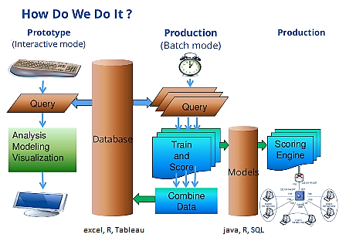
methodology
Back
Notes:
-SQL – lag function
-R scripts

Slide 25
Predictive model
Example Phenomenon
Pricing
Size of Customer
Salesman effect
Bid to order effect
Splits/Backorders
Number of functionality
Tenure
Number of Users
Pro Plus Customer
Channel Acquired
Breadth of products
Percentage of Job Sales
Other dynamic variables
Phenomenon
Can we measure this?
No
Yes
Do we Measure this
No
Yes
Unobserved
Var1
Var2
Var3
Var4
-There are alterative variables and variable measurements which can be used to represent the same phenomenon
Back

Slide 26
Predictive model
probabilistic models
Logistic Regression
Input Data
Decision Tree
Weighted Probability
Naïve Bayes
Decision Rules
Churn?
*Diagnostic measurements are obtained through cross validation best practices
Back

Slide 27
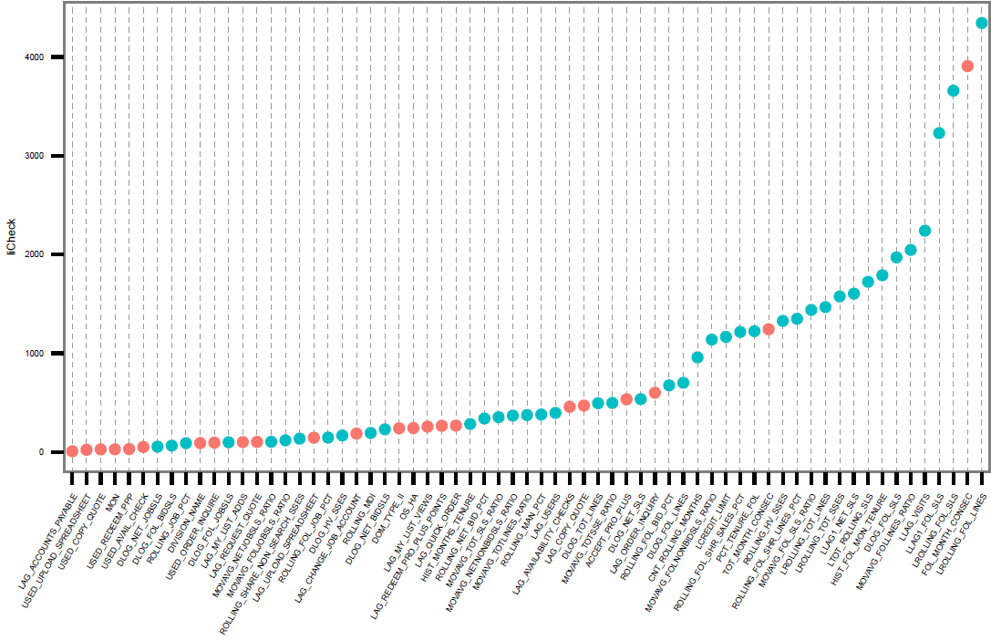
Top variables- Log likelihood
Variables
Categorical
Numeric
Back

Slide 28
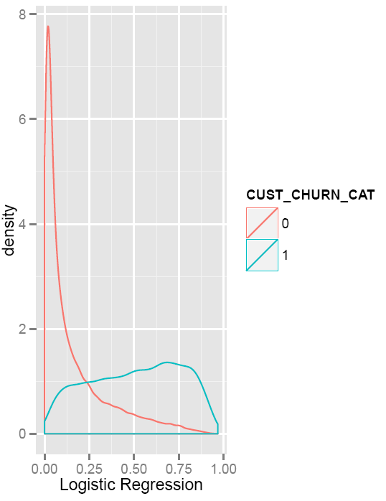
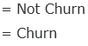
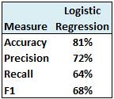
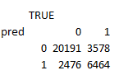
Logistic regression
Logistic Regression model does well at separating the two groups, but, has mild overlap
It is better at predicting the churn vs. not-churn categories
Back

Slide 29
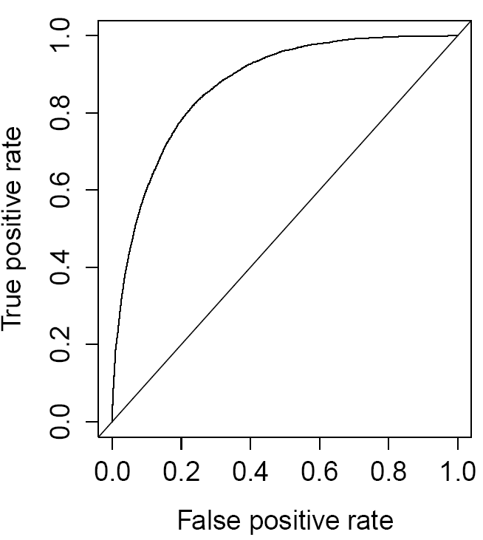
Logistic regression
Lift compared to random guess
Logistic Regression is precise
Back

Slide 30
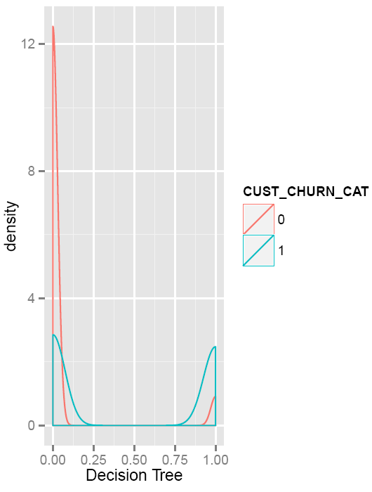
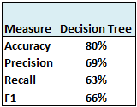
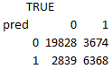
Decision Tree
Decision Tree again predicts non-churners very well
Has difficulty predicting the churning group
Back

Slide 31
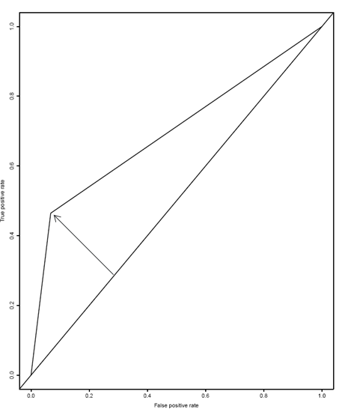
Decision tree
However AUC is not as high as LR
Decision Tree is able to quickly gain efficiencies
Back

Slide 32
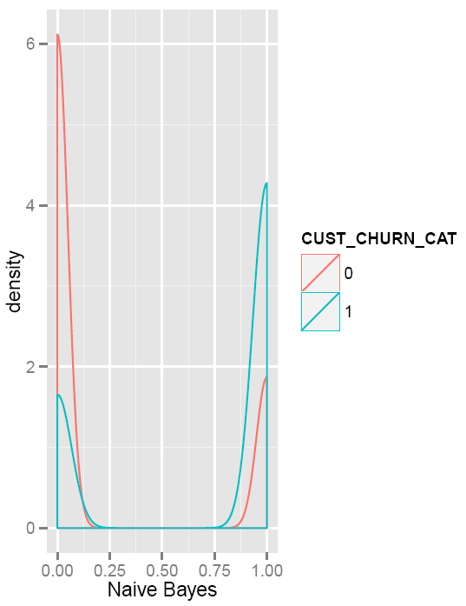
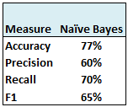
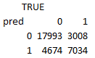
Naïve Bayes
Naïve Bayes is better able to pick out the churning customers than logistic regression and the decision tree
Naïve Bayes does a poor job at picking those customers who are not going to churn compared to other models
Back

Slide 33
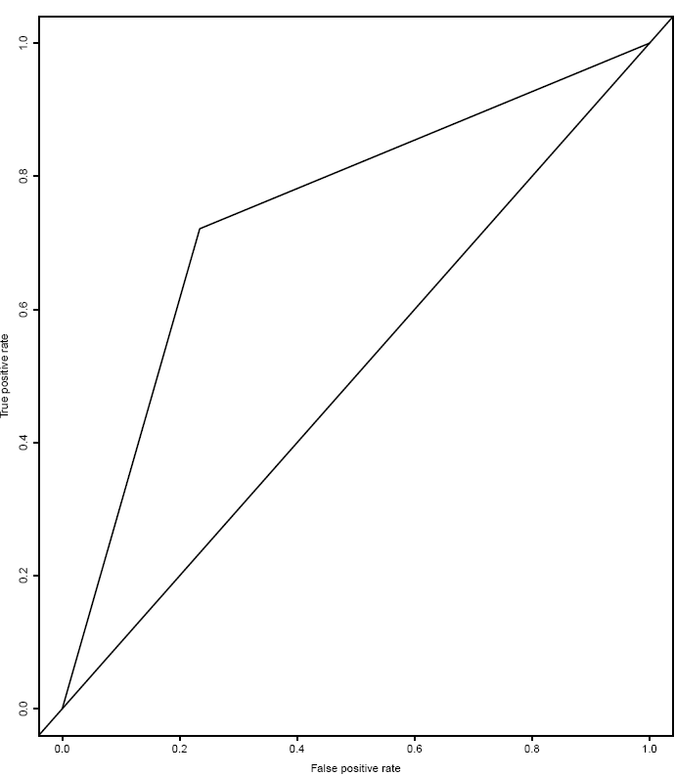
Naïve Bayes
N.B. does gain efficiencies over time
N.B. doesn’t quickly gain efficiencies
Back

Slide 34
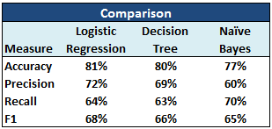
Model comparison
While Logistic Regression and the Decision Tree have similar measurements, their classification method is entirely different
Naïve Bayes stands out with its recall significantly higher than other models, but its precision is much lower
Back

Slide 35
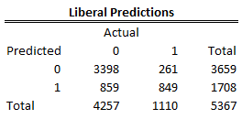
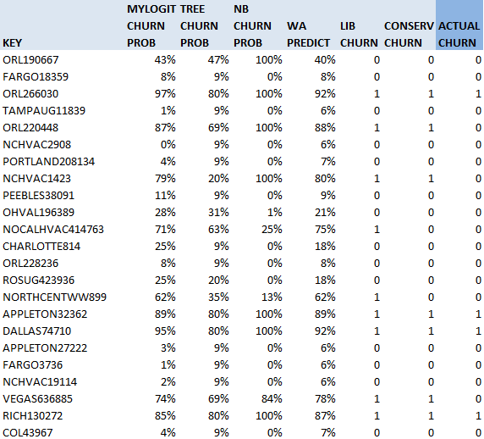
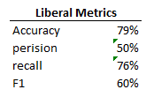
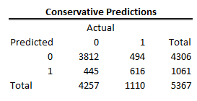
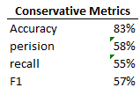
Sep predictions
Out of sample
Back

Slide 36
Further Research
This analysis used only information readily available in Branch Customer History (BCH)
BCH is a summary table maintained by eBusiness Analytics
A more accurate churn model would make use of a wider breadth of customer behavior on the website
Access to unobserved variables’ data would increase accuracy
Last sales visit
Nature of visit
Customer feedback
Positive or negative site interaction
Change timeframe
Customers place a larger than average order before churning, and take 1-2 months to reengage
Back

Slide 37
Review of presentation goals
Churn Predictive Model Example
Documentation of Analysis
What is appropriate here?
Standard is to be able to recreate analysis from start to finish
Objective Model Evaluation Standards
New model should beat null model to put in production
If current model exists, out of sample predictions of new model should consistently beat current model to switch model used in production
Keep it objective
Quick R demo
R is cool
R is free
To download R go here:
https://cran.r-project.org/bin/windows/base/

Slide 38
APPENDIX A
Data Distributions & Predictive Power
Histograms and conditional probability of all predictor variables used in analysis
Note: some variables have been truncated in data pull due to data validation and extremes to decrease their leverage on the model
Ex) Count of total SSEs:
log of 1 = 0, many customers with 1 SSE
Back

Slide 39
Predictive model
Identify readily available variables, phenomenon believed to affect churn
Thought through the lens of observable data, however, it is likely there are many unobservable data points which affect churn which we are not capturing
Brainstormed Phenomenon:
Variable Measurement:
Appendix A contains a detailed list of each variable and its predictive accuracy (not holding other variables constant)
Alternative variations of measurement are possible
Pricing
Size of Customer
Salesman effect
Bid to order effect
Splits/Backorders
Number of functionality
Tenure
Number of Users
Pro Plus Customer
Channel Acquired
Breadth of products
Percentage of Job Sales
Other dynamic variables
Back
Notes:
-High SSE’s → Good or bad
-Healthy skepticism

Slide 40
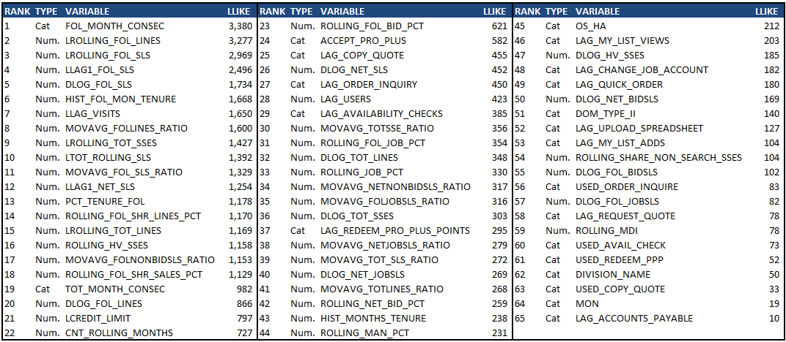
Top variables – log likelihood method
Back

Slide 41
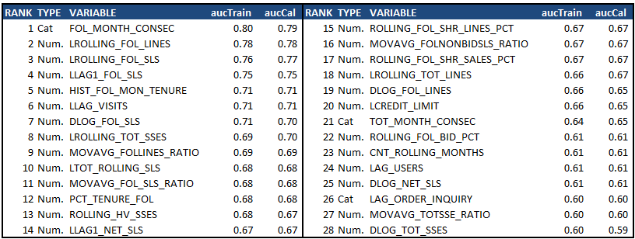
Top variables (28) – Auc
Back

Slide 42
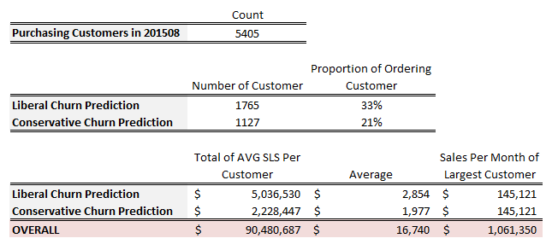
Using churn predictions
Between 21%-33% of ordering customers are expected to churn next month
2.2 – 5 Million dollars in sales per month are expected to churn next month
Very large customers do not often churn
The highest churning customer’s sales per month is 145k (1.7 mil annual)
Back

Slide 43
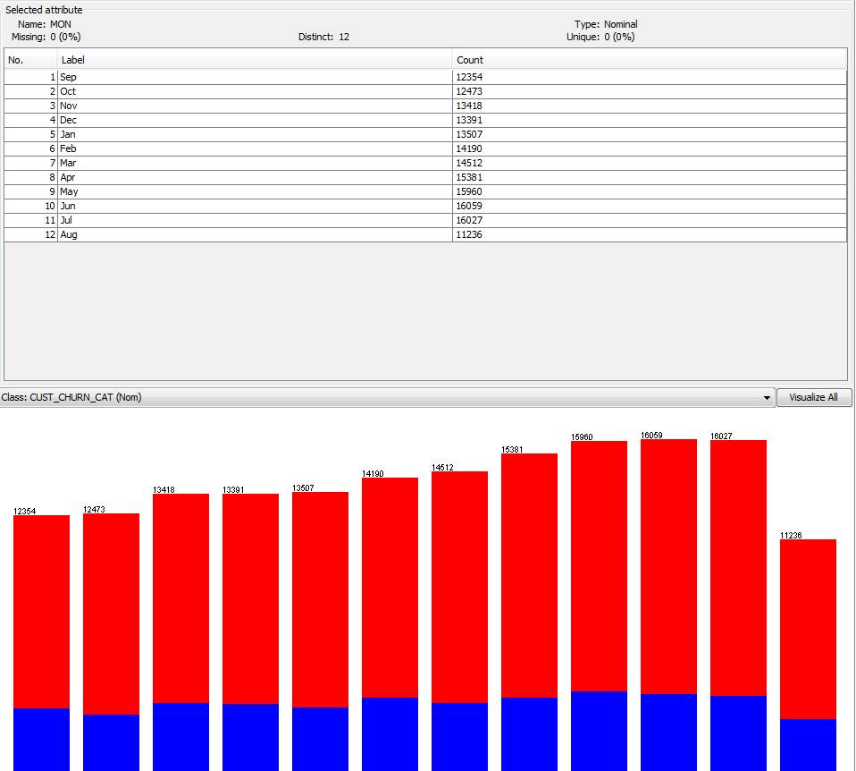
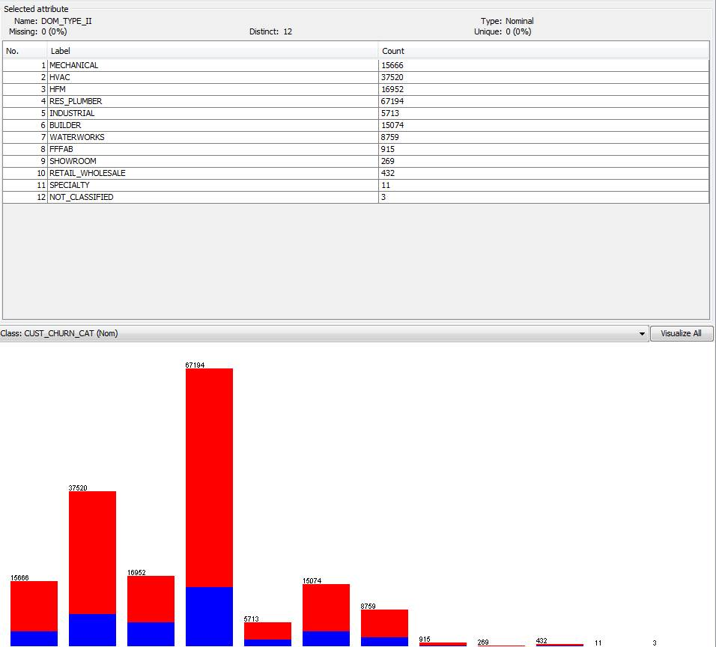
Data distributions
1-2
Months
Dominant Customer Type
Non-churn
Churn
Back

Slide 44
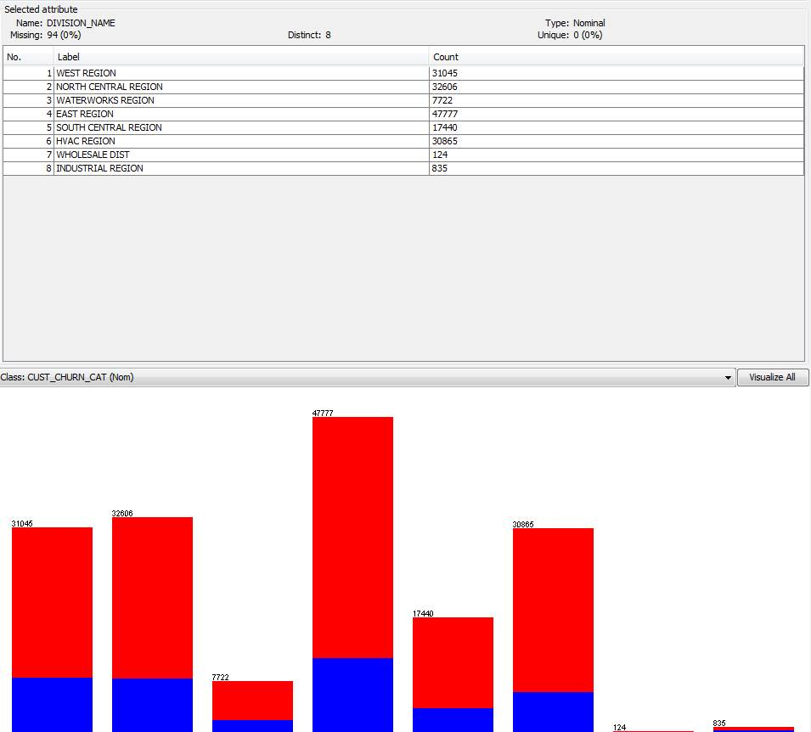
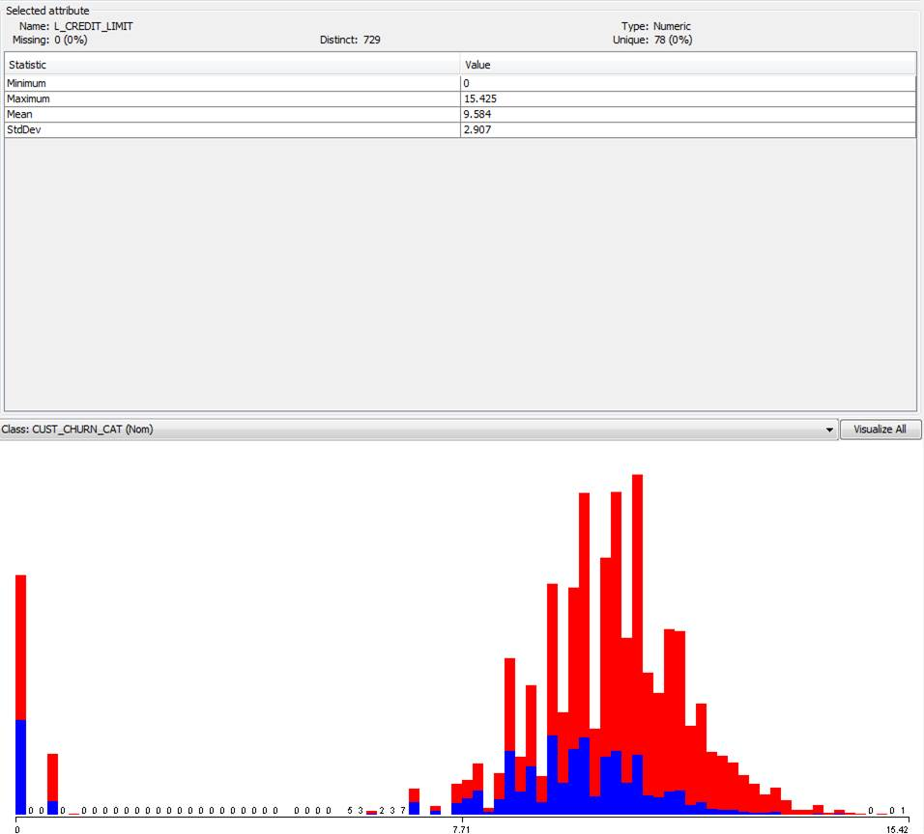
Data distributions
3-4
Division Name
Log of Credit Limit
Non-churn
Churn
Back

Slide 45
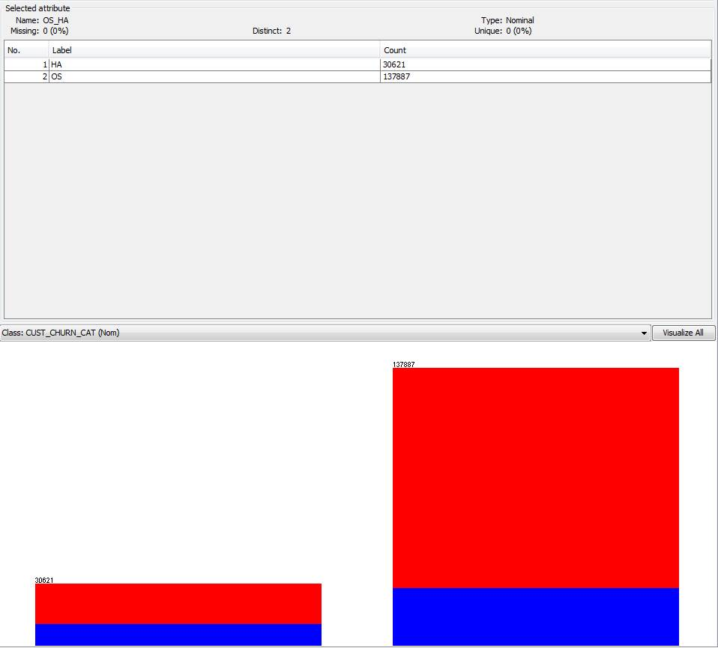
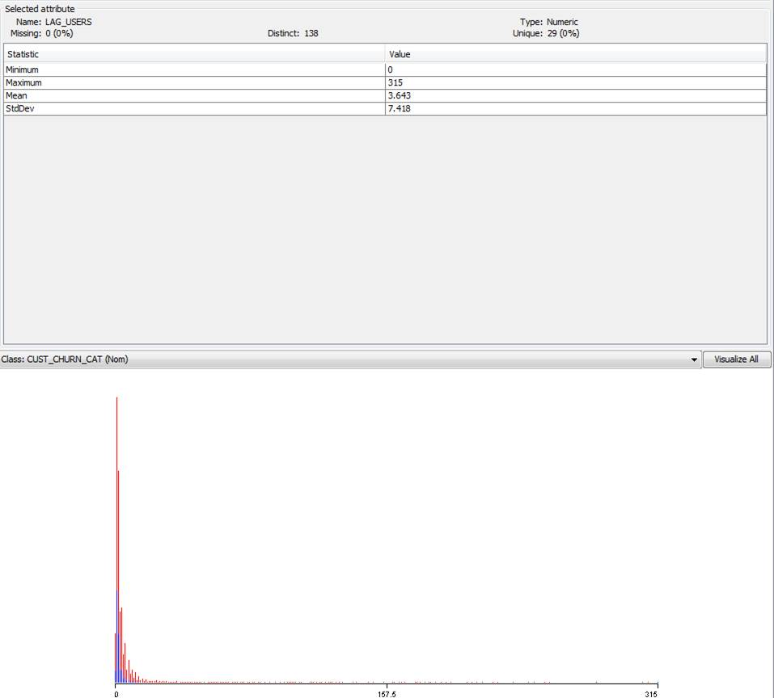
Data distributions
5-6
Outside Sales/House Account
Lagged Users
Non-churn
Churn
Back
Notes:
*Changed to log normal

Slide 46
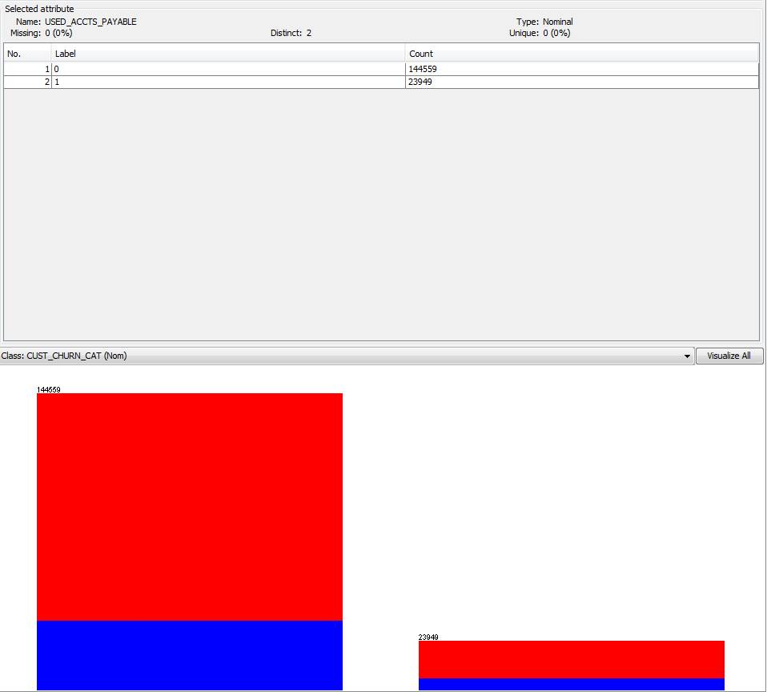
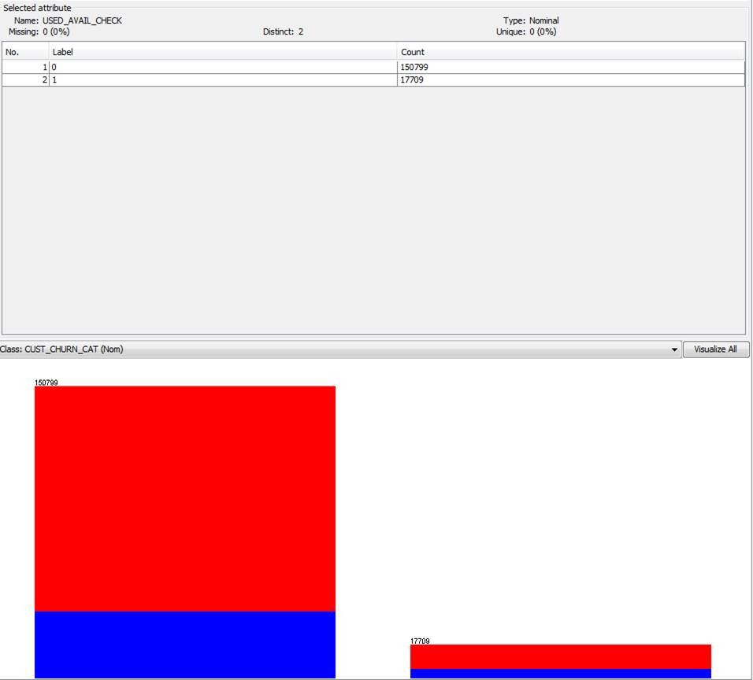
Data distributions
7-8
Used Account Payable
Used Availability Check
Non-churn
Churn
Back

Slide 47
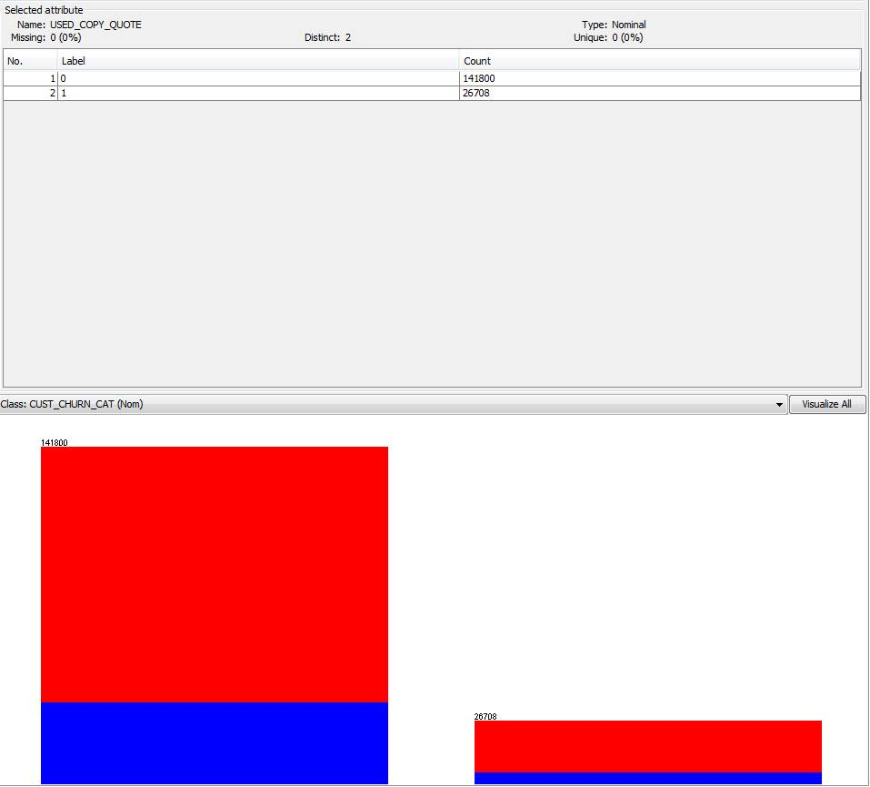
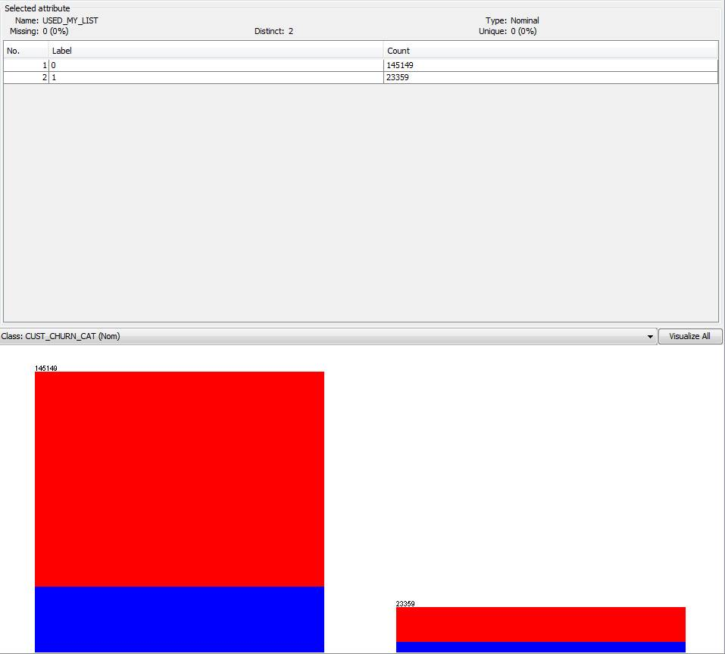
Data distributions
9-10
Used Copy Quote
Used My List
Non-churn
Churn
Back

Slide 48

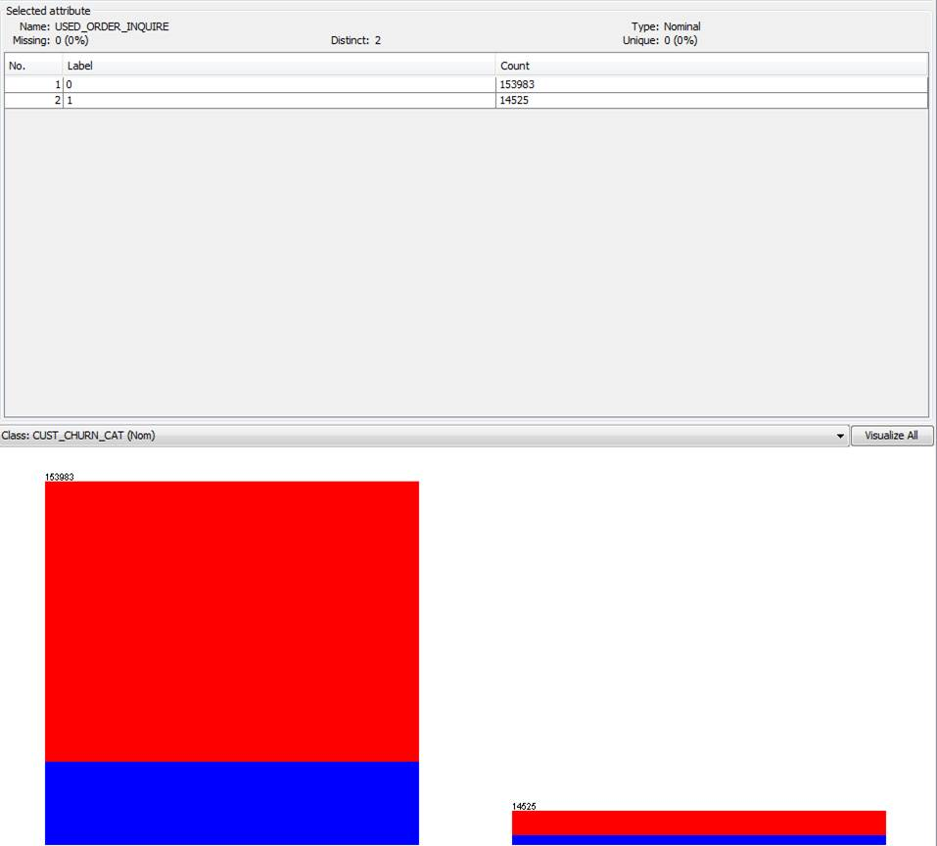
Data distributions
11-12
Used Online Bill Pay
Used Order Inquire
Non-churn
Churn
Back

Slide 49
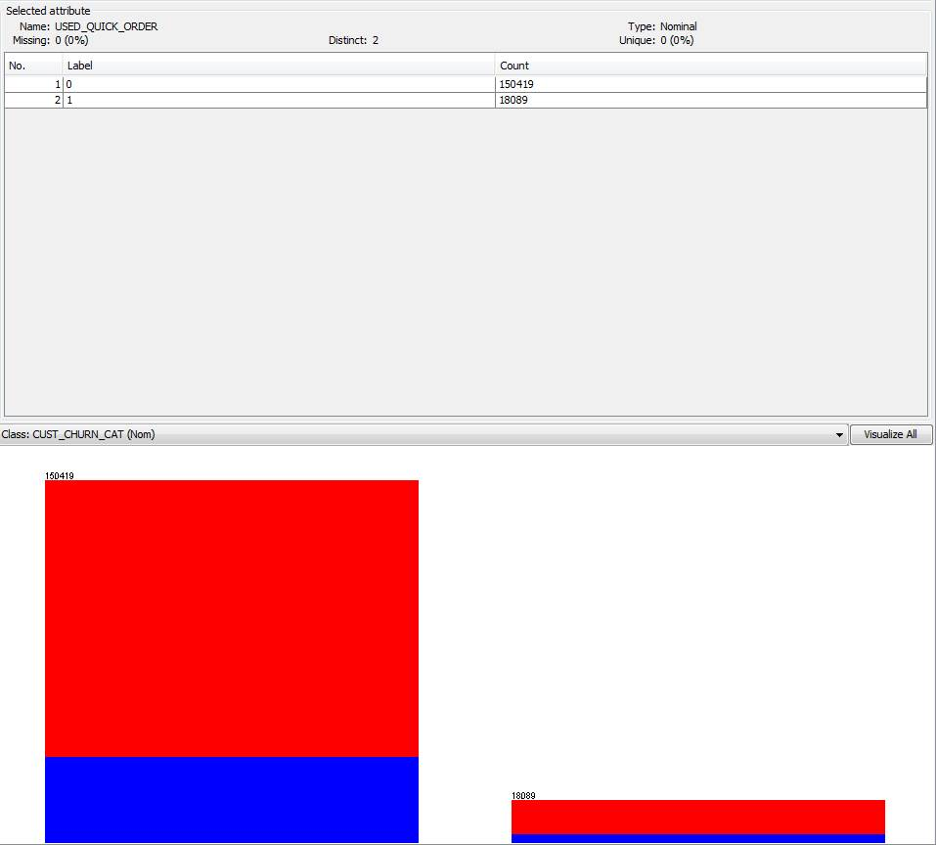
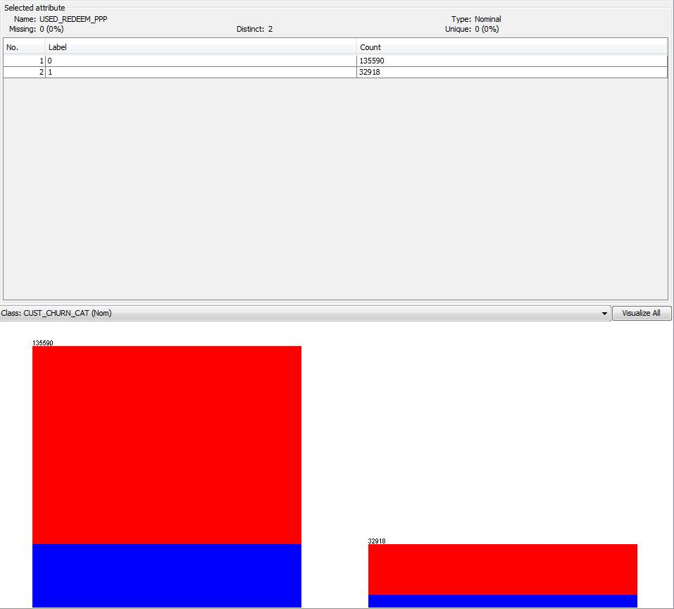
Data distributions
13-14
Used Quick Order
Used Redeem Pro Plus Points
Non-churn
Churn
Back

Slide 50
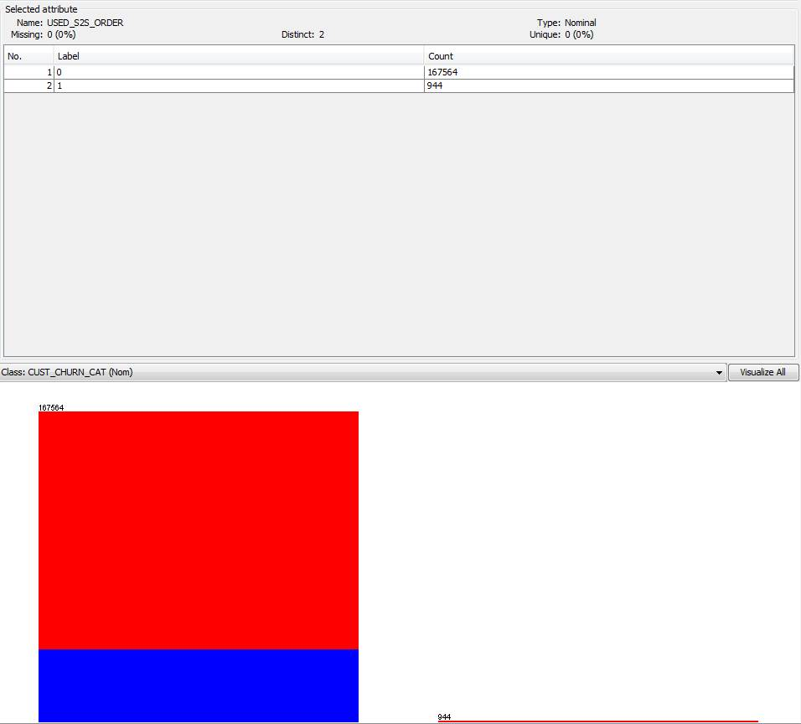
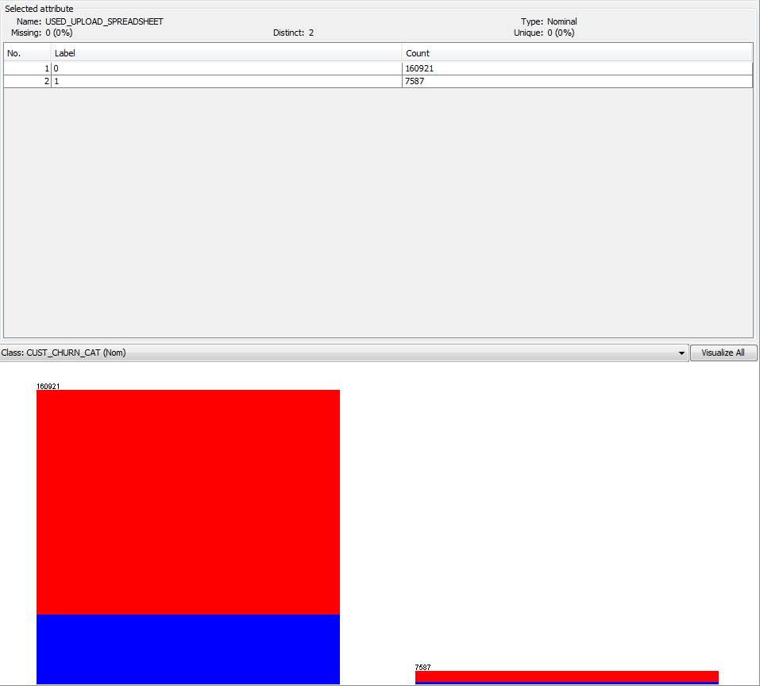
Data distributions
15-16
Used S2S Order
Used Upload Spreadsheet
Non-churn
Churn
Back

Slide 51
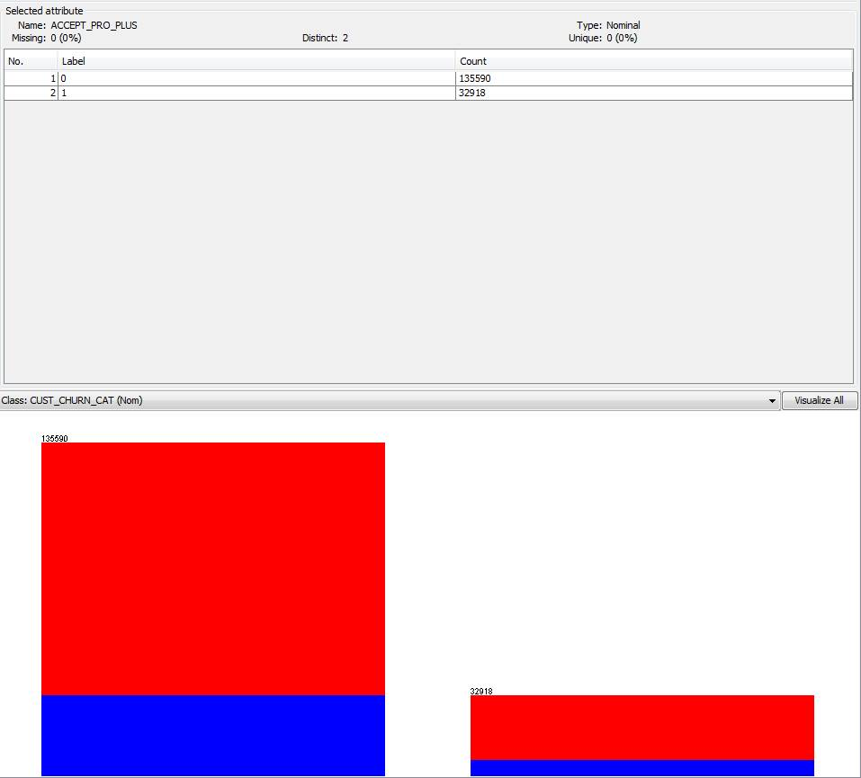
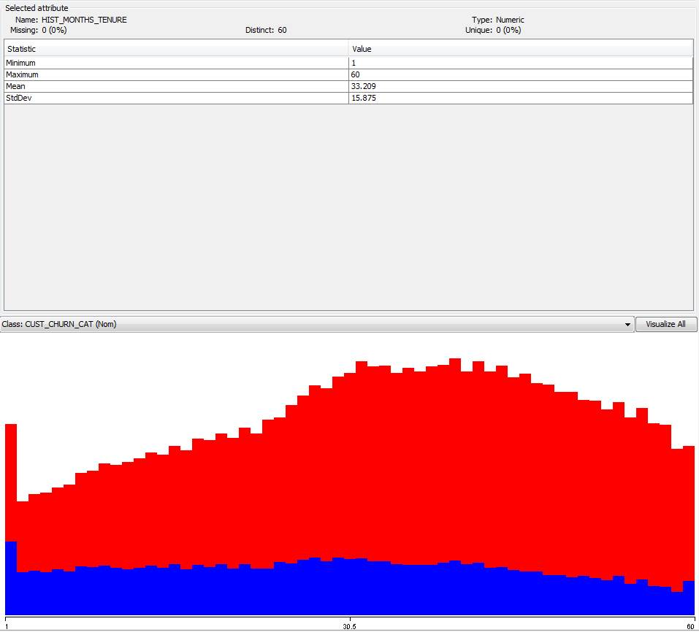
Data distributions
17-18
Accepted Pro Plus
Historical Months Tenure
Non-churn
Churn
Back

Slide 52
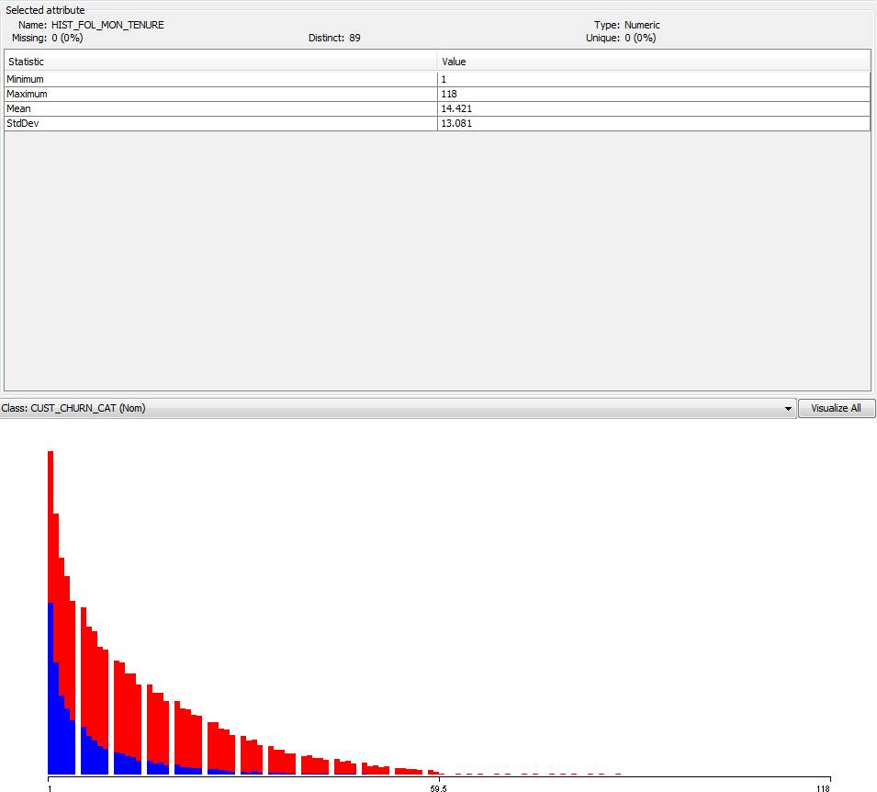
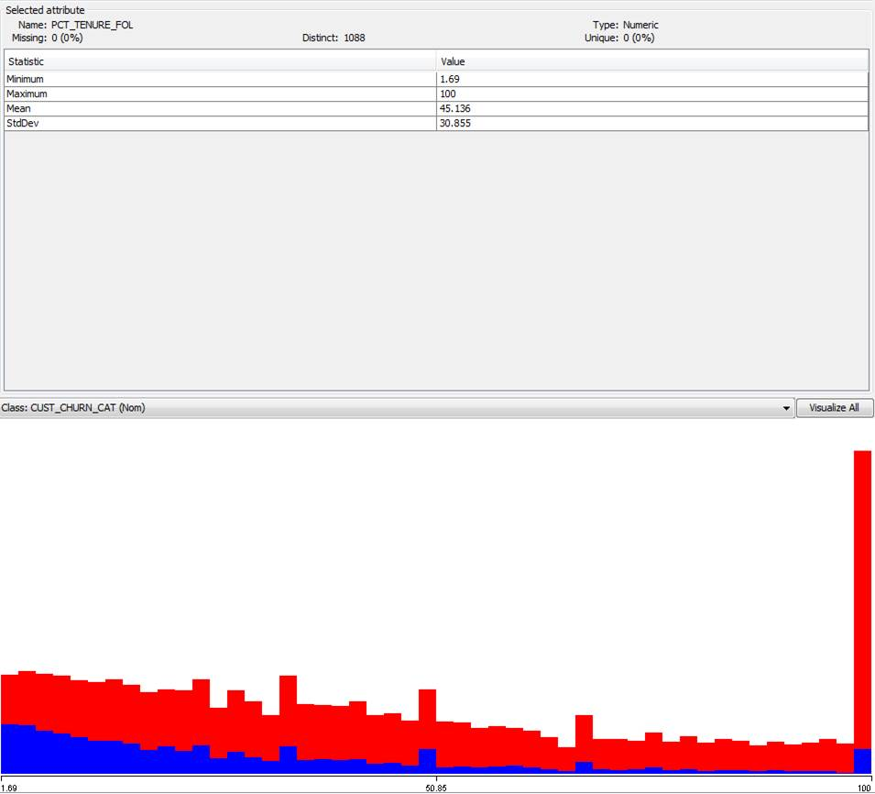
Data distributions
19-20
Historical FOL Months Tenure
FOL Percentage of Ferguson Tenure
Non-churn
Churn
Back

Slide 53
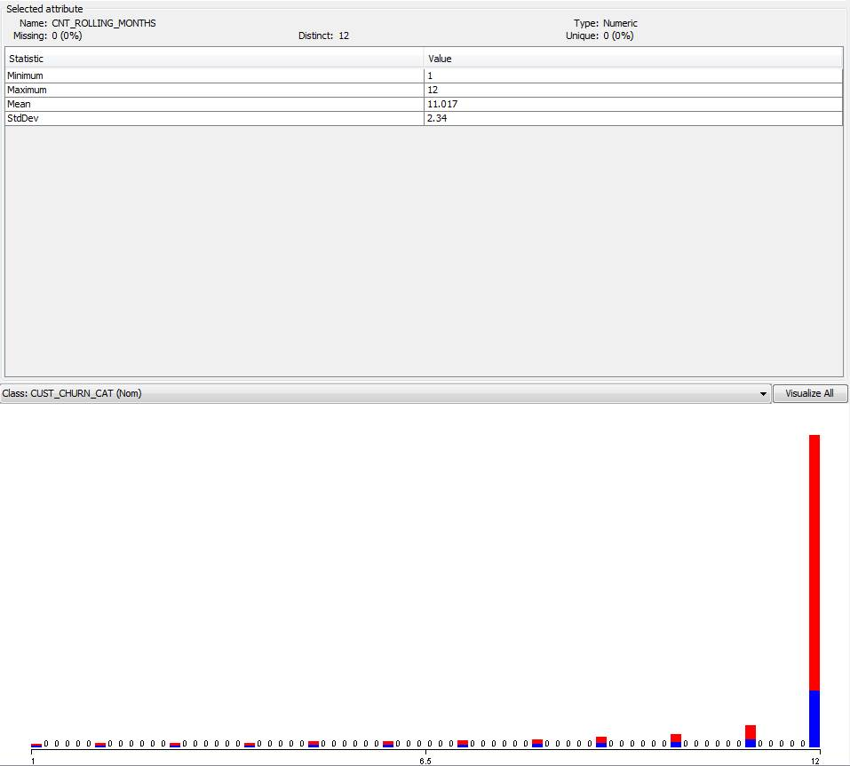
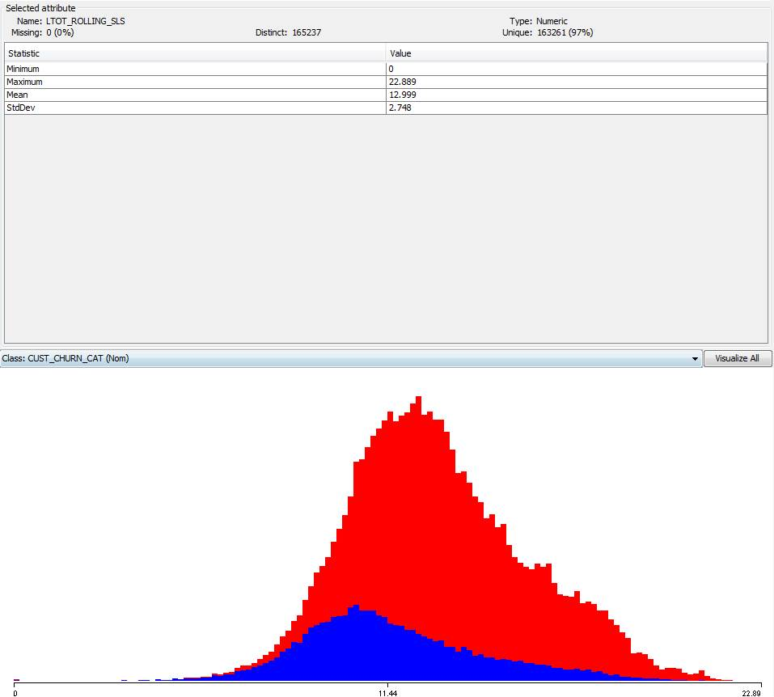
Data distributions
21-22
Count of Rolling Months
Log Total Rolling Sales
Non-churn
Churn
Back

Slide 54
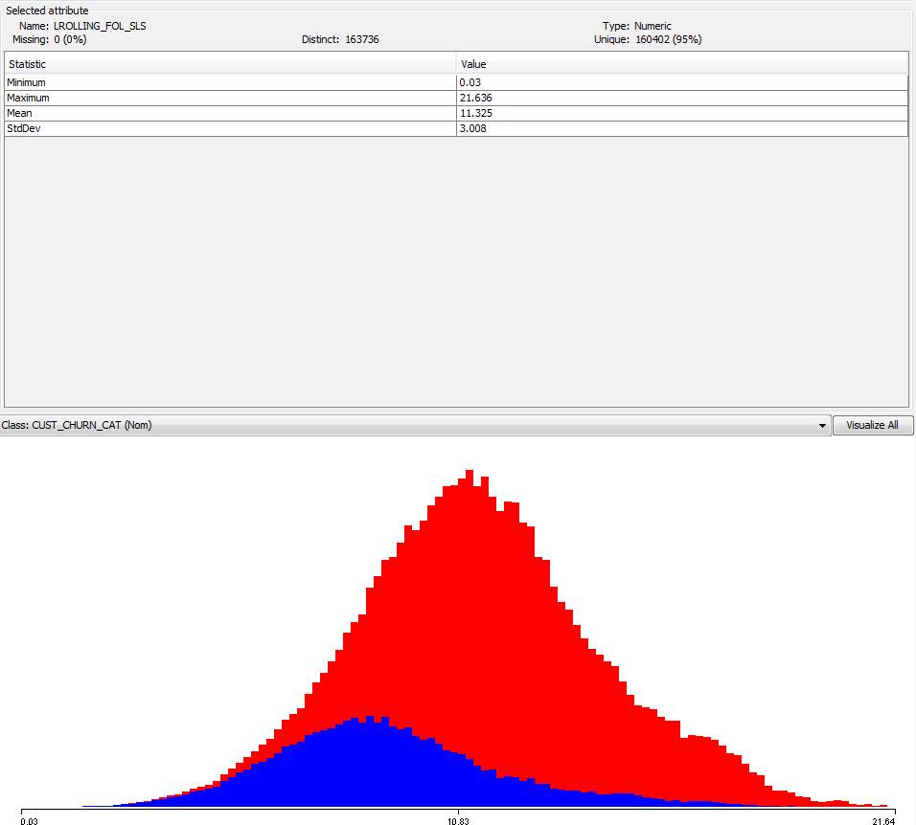
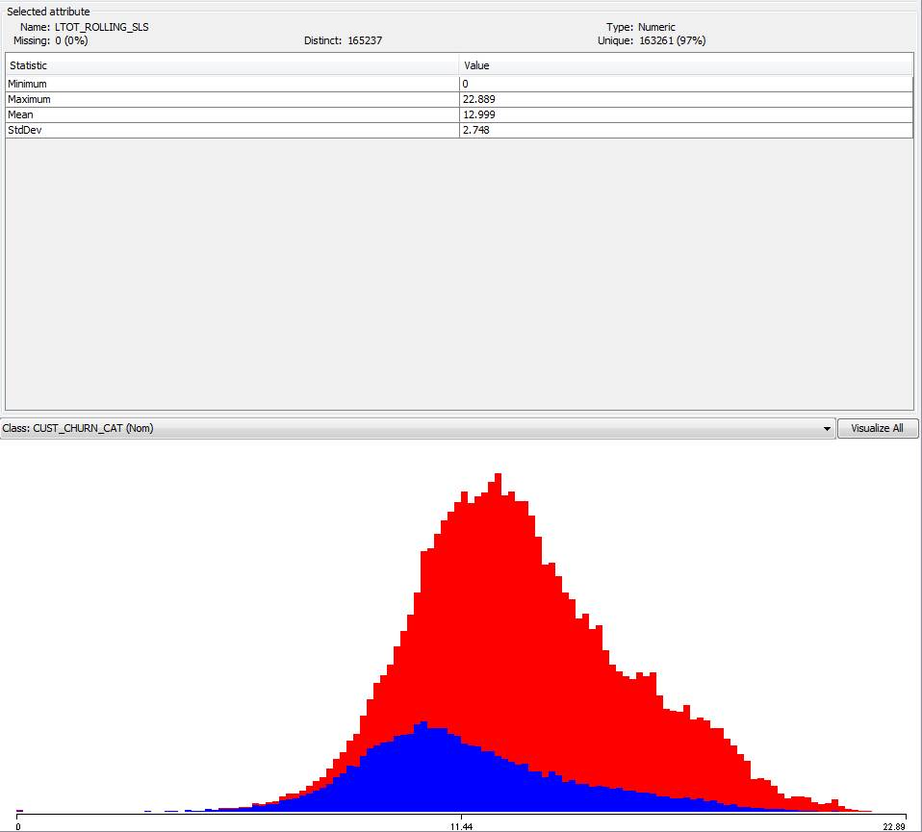
Data distributions
23-24
Log Rolling FOL Sales
Log Rolling FOL Lines
Non-churn
Churn
Back

Slide 55


Data distributions
25-26
Log Rolling Total Lines
Log Rolling Total SSEs
Non-churn
Churn
Back

Slide 56


Data distributions
27-28
Log Rolling Non-Search SSEs
Rolling Share Non-Search SSEs
Non-churn
Churn
Back

Slide 57


Data distributions
29-30
Rolling Mean Deviation Index
Rolling Manual PCT
Non-churn
Churn
Back

Slide 58


Data distributions
31-32
Rolling Job PCT
Rolling FOL Share Sales PCT
Non-churn
Churn
Back

Slide 59


Data distributions
33-34
Rolling Net Bid PCT
Rolling FOL Bid PCT
Non-churn
Churn
Back

Slide 60


Data distributions
35-36
Rolling FOL Job PCT
Rolling FOL Share of Lines PCT
Non-churn
Churn
Back

Slide 61


Data distributions
37-38
Moving Average Total Sales Ratio
Moving Average Net Job Sales Ratio
Non-churn
Churn
Back

Slide 62


Data distributions
39-40
Moving Average FOL Sales Ratio
Moving Average Net Bid Sales Ratio
Non-churn
Churn
Back

Slide 63


Data distributions
41-42
Moving Average FOL Non-Bid Sales Ratio
Moving Average FOL Job Sales Ratio
Non-churn
Churn
Back

Slide 64


Data distributions
43-44
Moving Average FOL Lines Ratio
Moving Average Total Lines Ratio
Non-churn
Churn
Back

Slide 65


Data distributions
45-46
Moving Average Total SSEs Ratio
Difference Log of Net Sales
Non-churn
Churn
Back

Slide 66


Data distributions
47-48
Difference Log of FOL Sales
Difference Log of Net Job Sales
Non-churn
Churn
Back

Slide 67


Data distributions
49-50
Difference Log of Net Bid Sales
Difference Log of FOL Bid Sales
Non-churn
Churn
Back

Slide 68


Data distributions
51-52
Difference Log of FOL Job Sales
Difference Log of FOL Lines
Non-churn
Churn
Back

Slide 69


Data distributions
53-54
Difference Log of Total Lines
Difference Log of Total SSEs
Non-churn
Churn
Back

Slide 70


Data distributions
55-56
Difference Log of HV SSEs
Log Lag1 of Net Sales
Non-churn
Churn
Back

Slide 71


Data distributions
57-58
Log Lag1 of FOL Sales
Total Consecutive Months
Non-churn
Churn
Back

Slide 72


Data distributions
59-60
FOL Consecutive Months
Customer Churn Categories
Non-churn
Churn
Back

Slide 73


Data distributions
61-62
Lag Accounts Payable
Lag Online Bill Pay Bill Trust
Churn
Non-Churn
Back

Slide 74


Data distributions
63-34
Lag Order Inquiry
Lag Request Quote
Churn
Non-Churn
Back

Slide 75


Data distributions
65-66
Lag My List Adds
Lag My List Views
Churn
Non-Churn
Back

Slide 76


Data distributions
67-68
Lag Upload Spreadsheet
Lag Quick Order
Churn
Non-Churn
Back

Slide 77


Data distributions
69-70
Lag Availability Checks
Lag Redeem Pro Plus Points
Churn
Non-Churn
Back

Slide 78


Data distributions
71-72
Lag Copy Quote
Lag Change Job Account
Churn
Non-Churn
Back

Slide 79
CONDITIONAL Probabilities
Back

Slide 80
CONDITIONAL PROB
The following slides highlight the conditional probabilities of churn with respect to churn.
These graphs will compare the conditional probability with the overall probability
Red fill indicate lower than overall probability to predict churn
Blue fill indicate higher than overall probability to predict churn
Back

Slide 81
Categorical variables
Back

Slide 82


Predictors – conditional prob
Used Upload Spreadsheet
Used S2S Order
Back

Slide 83


Predictors – conditional prob
Used Redeem PPP
Used Quick Order
Back

Slide 84


Predictors – conditional prob
Used Order Inquire
Used OLBP
Back

Slide 85


Predictors – conditional prob
Used My List
Used Copy Quote
Back

Slide 86


Predictors – conditional prob
Used Avil Check
Used ACCTS Payable
Back

Slide 87


Predictors – conditional prob
Tot Month Consec
OS_HA
Back

Slide 88


Predictors – conditional prob
Month
LAG_UPLOAD_SPREADSHEET
Back

Slide 89


Predictors – conditional prob
LAG_REQUEST QUOTE
LAG_REDEEM_PRO_PLUS_POINTS
Back

Slide 90


Predictors – conditional prob
LAG_QUICK_ORDER
LAG_ORDER_INQUIREY
Back

Slide 91

Predictors – conditional prob
LAG_ONLINE_BILL_PAY
LAG_MYLIST_VIEW
Back

Slide 92


Predictors – conditional prob
LAG_MYLIST_ADD
LAG_COPY_QUOTE
Back

Slide 93


Predictors – conditional prob
LAG_CHANGE_JOB_ACCT
LAG_AVIL_CHECK
Back

Slide 94


Predictors – conditional prob
LAG_ACCOUNTS_PAYABLE
FOL_MONTHS_CONSEC
Back

Slide 95


Predictors – conditional prob
DOM_TYPE_II
DIVISION
Back

Slide 96

Predictors – conditional prob
ACCEPTED ACCOUNTS PAY
Back

Slide 97
Numeric variables
Back

Slide 98


Predictors – conditional prob
LLAG_SHARE_NON_SEARCH_SSES
ROLLING_NET_BID_PCT
Back

Slide 99


Predictors – conditional prob
ROLLING_MDI
ROLLING_MAN_PCT
Back

Slide 100


Predictors – conditional prob
ROLLING_JOB_PCT
ROLLING_HV_SSES
Back

Slide 101


Predictors – conditional prob
ROLLING_FOL_SHARE_PCT
ROLLING_FOL_SHR_LINES
Back

Slide 102


Predictors – conditional prob
ROLLING_FOL_JOB_PCT
ROLLING_FOL_JOB_BID_PCT
Back

Slide 103


Predictors – conditional prob
PCT_TENURE_FOL
LOG_TOTAL_ROLLING_SALES
Back

Slide 104


Predictors – conditional prob
LOG_ROLLING_TOT_SSES
LOG_ROLLING_TOT_LINES
Back

Slide 105


Predictors – conditional prob
LOG_ROLLING_FOL_SLS
LOG_ROLLING_FOL_LINES
Back

Slide 106


Predictors – conditional prob
LAG_LOG_NET_SALES
LAG_LOG_FOL_SLS
Back

Slide 107


Predictors – conditional prob
LAG_USERS
LOG_CREDIT_LIMIT
Back

Slide 108

Predictors – conditional prob
LAG_LOG_TOTAL_VISITS
LOG_ROLLING_FOL_LINES
Back

Slide 109


Predictors – conditional prob
COUNT ROLLING MONTHS
DLOG FOL BID SLS
Back

Slide 110


Predictors – conditional prob
DLOG FOL JOB SALES
DLOG FOL LINES
Back

Slide 111


Predictors – conditional prob
DLOG FOL SALES
DLOG HV SSES
Back

Slide 112


Predictors – conditional prob
DLOG NET BID SALES
DLOG NET JOB SALES
Back

Slide 113


Predictors – conditional prob
DLOG TOTAL SALES
DLOG TOTAL LINES
Back

Slide 114


Predictors – conditional prob
DLOG TOT SSES
FOL HIST MONTH TENURE
Back

Slide 115

Predictors – conditional prob
HIST MONTHS TENURE
Back

Slide 116
APPENDIX B
Files
Other charting
Back

Slide 117
APPENDIX B
To recreate any portion of the analysis, all needed files should are located:
S:\eCommerce\E-Commerce\Analysis & Reporting\Omni-Channel\churn project
This assumes that Branch Customer History is still in-use and up-to-date
Back

Slide 118

Appendix b
Decision tree
Visual Representation of decision tree
Back

Slide 119

Model to weight predictive models
Back

Slide 120


